Slide 1

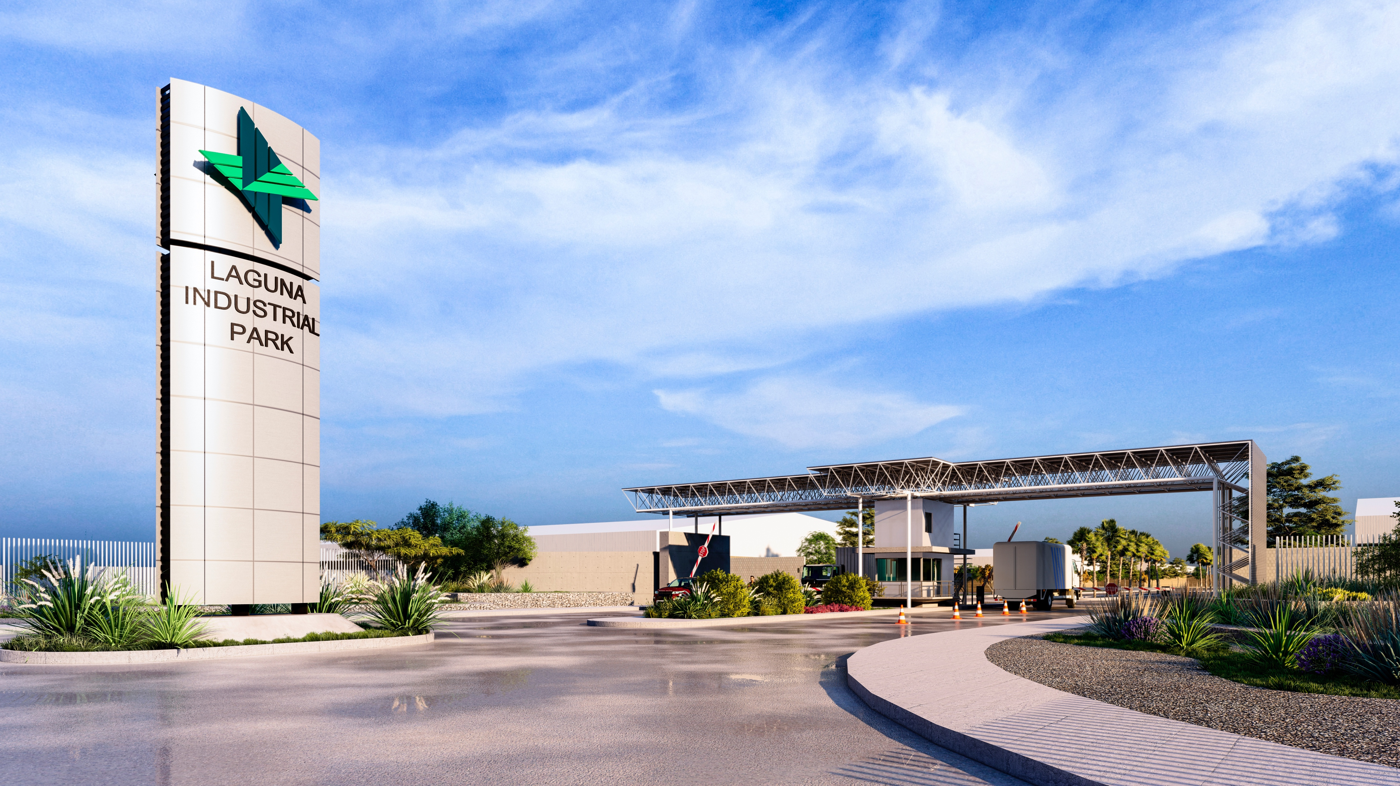

Slide 2

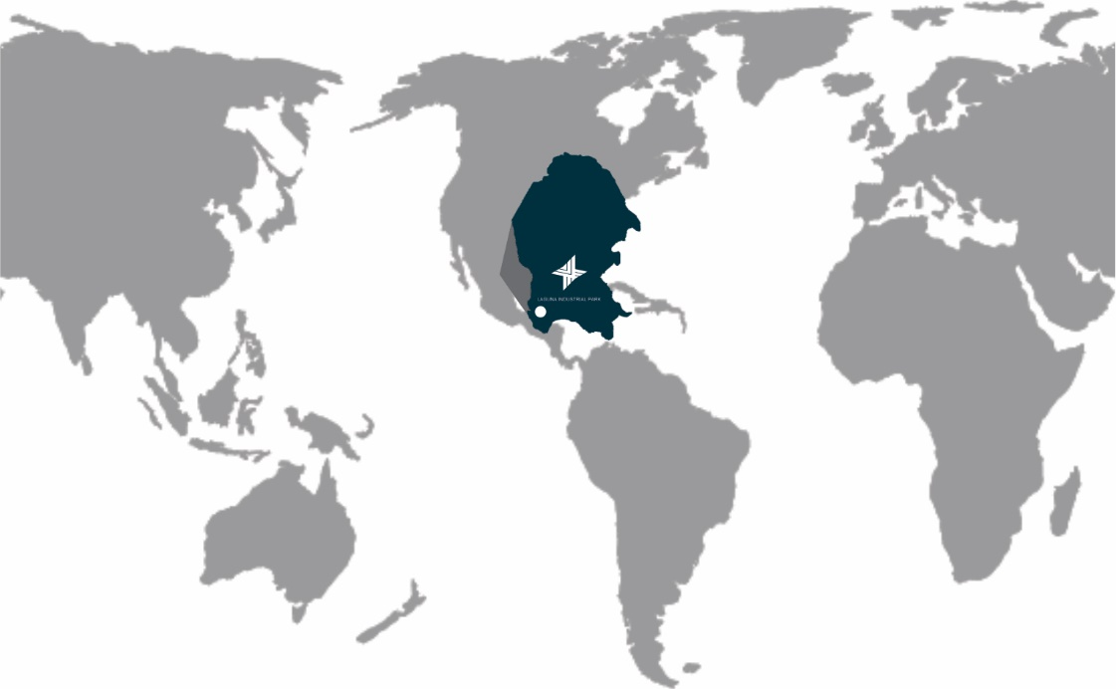
Main advantages Laguna Industrial Park
Privileged location in northeastern Mexico
Excellent connectivity, adjacent to federal highway 40 Torreon – Saltillo – Monterrey
Class A industrial infrastructure
Availability of skilled labor force
Wide educational offer
Business oriented Government Security and social peace
Quality of life
6

Slide 3
About Laguna Industrial Park
More than 35 Hectares of opportunity
Three phases Phase I: 4.74 has. (Under development) Phase II: 15.95 has. (To be developed) Phase III: 20.22 has.(To be developed)
Land available for sale
“Build To Suit”
Spec building for Lease / Sales (Under development 46,000 f²)
All the services at the edge of the lots.
7

Slide 4
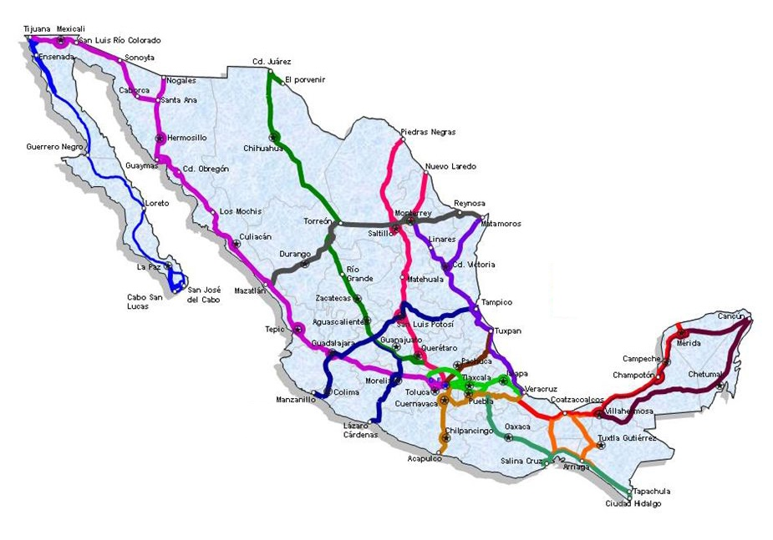
Logistic benefits
Main US Borders
Distances from LIP to: | Km: | Mi:
Brownsville, Tx. | 647 | 402
El Paso, Tx. | 849 | 527
Laredo, Tx. | 534 | 332
MacAllen, Tx. | 554 | 344
Nogales, Az. | 1,180 | 733
San Diego, Ca. | 1,851 | 1,150
Main Cities in Mexico
Distances from LIP to: | Km: | Mi:
Aguascalientes, Ags. | 544 | 338
Chihuahua, Chih. | 482 | 299
Durango. Dgo. | 258 | 160
Guadalajara, Jal. | 765 | 475
Guanajuato, Gto. | 723 | 449
México City | 1,026 | 637
Puebla, Pue. | 1,152 | 715
Queretaro. Qro. | 821 | 510
Monterrey, N.L. | 326 | 202
San Luis Potosi. S.L.P. | 603 | 374
Main Sea Ports Gulf of Mexico
Distances from LIP to: | Km: | Mi:
Altamira, Tamps. | 806 | 500
Tampico, Tamps. | 828 | 514
Tuxpan, Ver. | 1,000 | 621
Veracruz, Ver. | 1,300 | 807
Main Sea Ports Pacific Ocean
Distances from LIP to: | Km: | Mi:
Lazaro Cardenas, Mich. | 1,154 | 717
Manzanillo, Col. | 1,048 | 651
Mazatlan, Sin. | 518 | 322
8

Slide 5
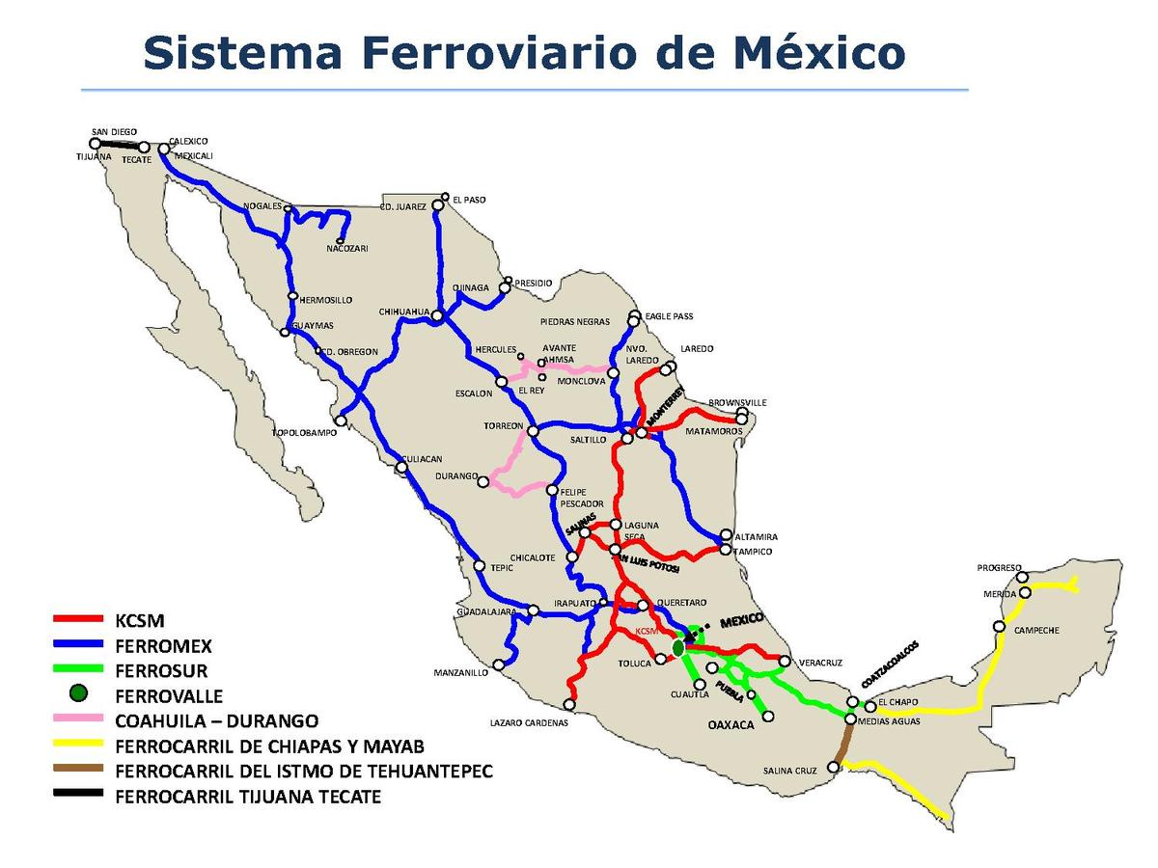

Rail network
INTERMODAL CARGO TERMINAL
Connection the main railway lines of the country
Federal custom with direct access to the terminal
12 mi. from Laguna Industrial Park
9

Slide 6
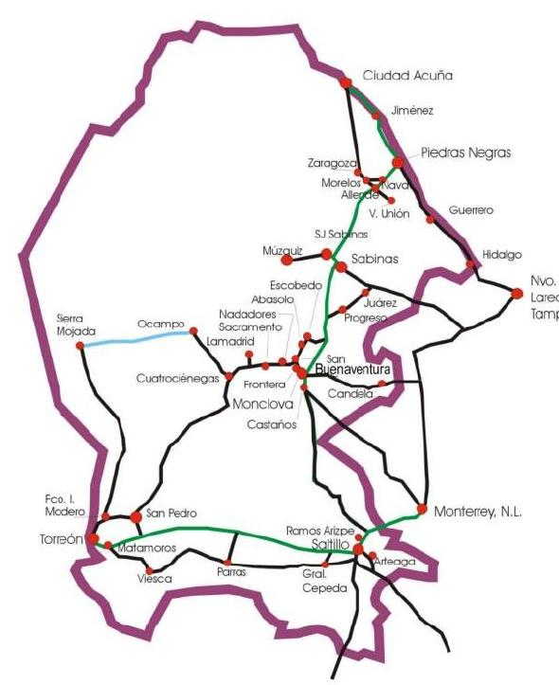
Location within Coahuila
Main US Borders in Coahuila
Distances from LIP to: | Km: | Mi:
Piedras Negras, Coah./ Eagle Pass, Tx. | 547 | 340
Acuña, Coah./ Del Rio, Tx. | 607 | 377
Main Cities in Coahuila
Distances from LIP to: | Km: | Mi:
Monclova, Coah. | 329 | 204
Sabinas, Coah.. | 423 | 263
Saltillo, Coah. | 244 | 151
10

Slide 7
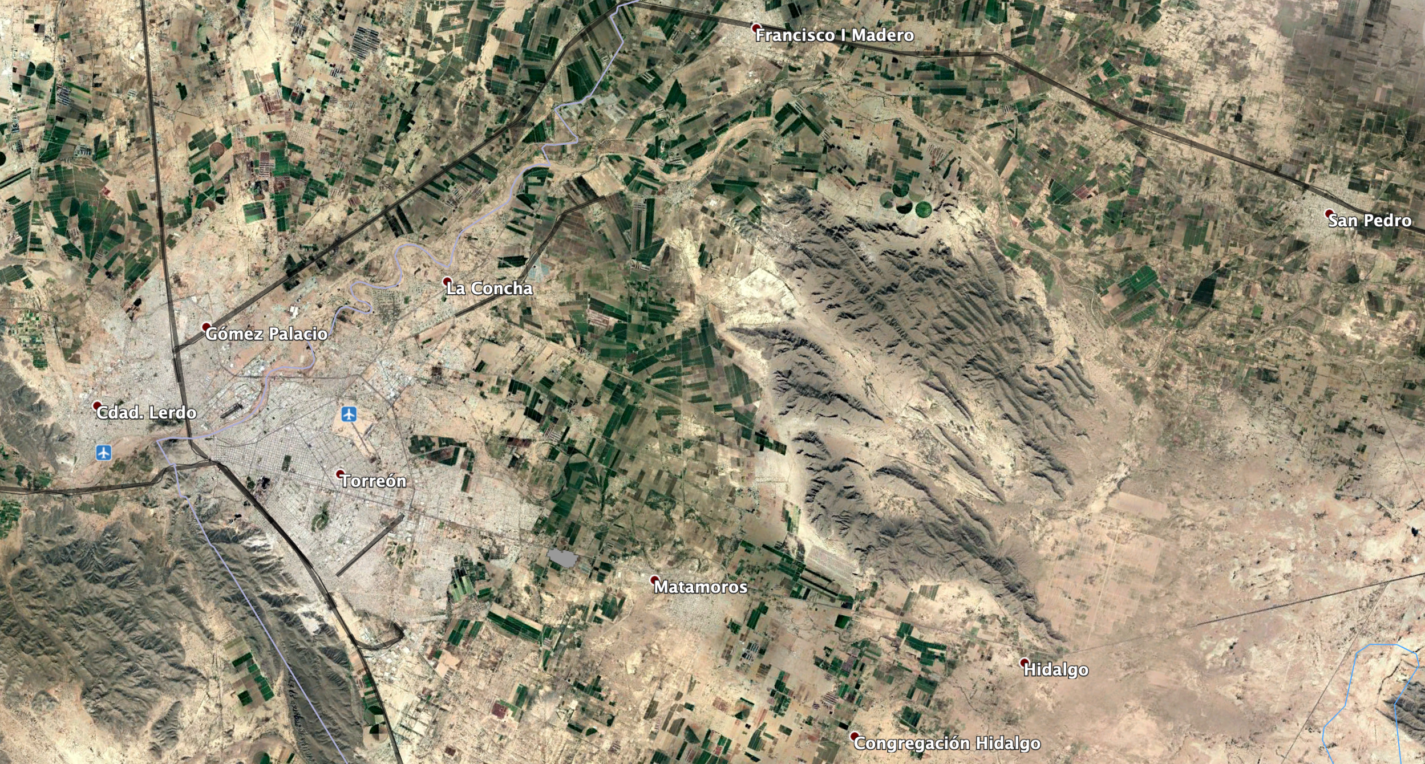

Strategic location in La Laguna Region
11

Slide 8
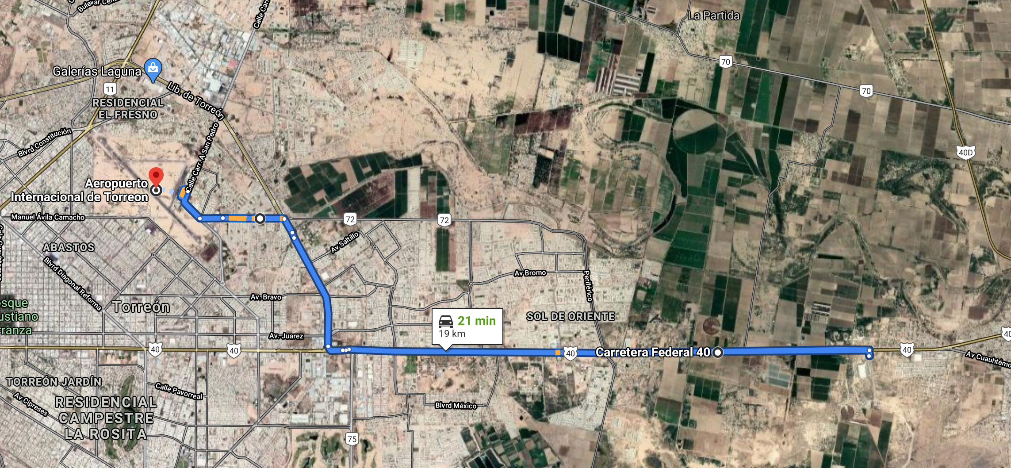
Strategic location in La Laguna Region
11.8 mi. (19 km.) from the Torreon International Airport.
12

Slide 9
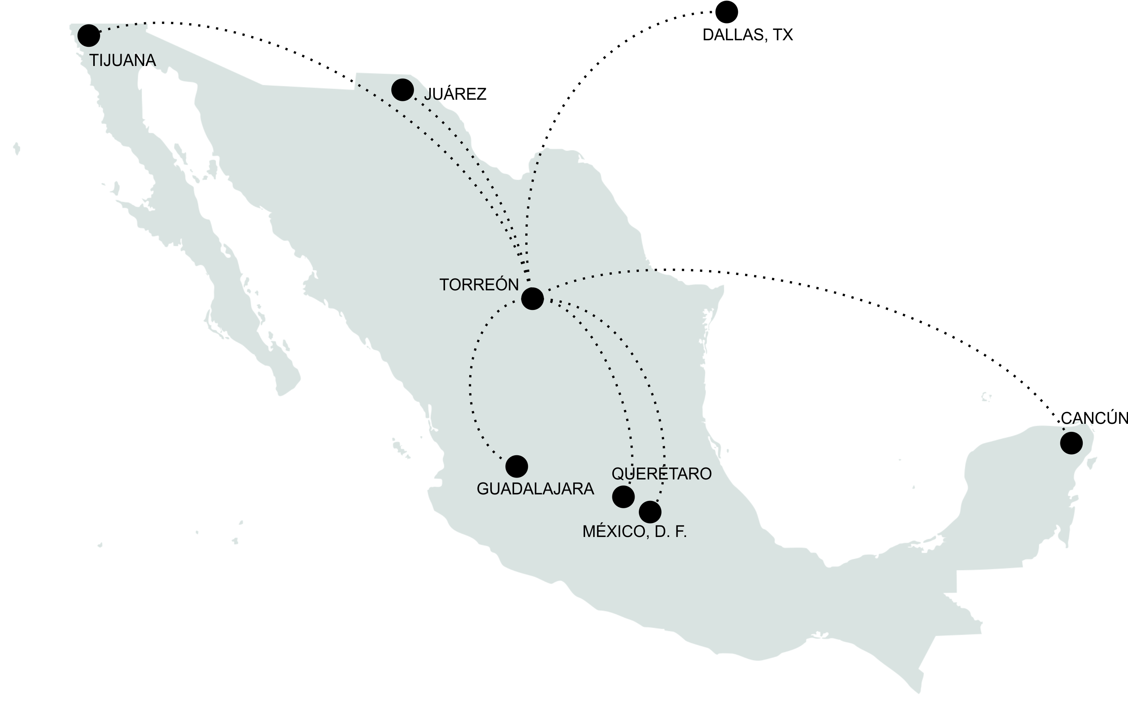


Internationa airport Torreon
13

Slide 10
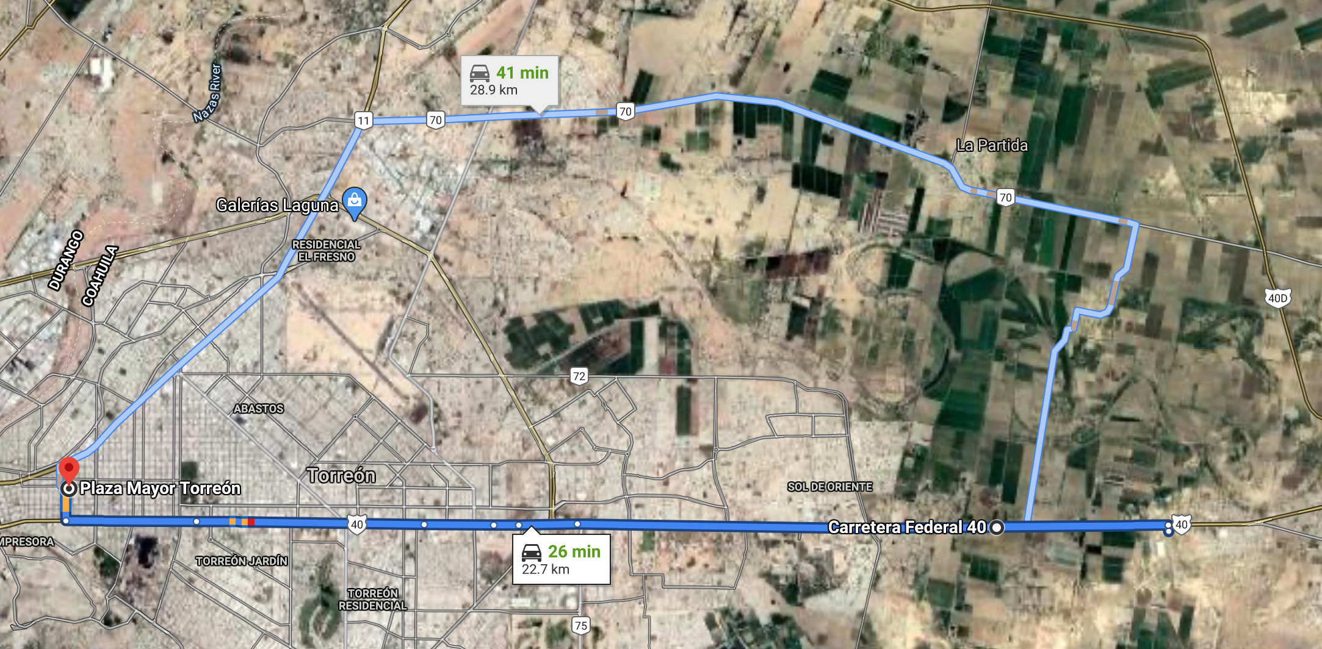
Strategic location in La Laguna Region
14.1 mi. (22.7) km from Torreon, Coahuila downtown.
14

Slide 11
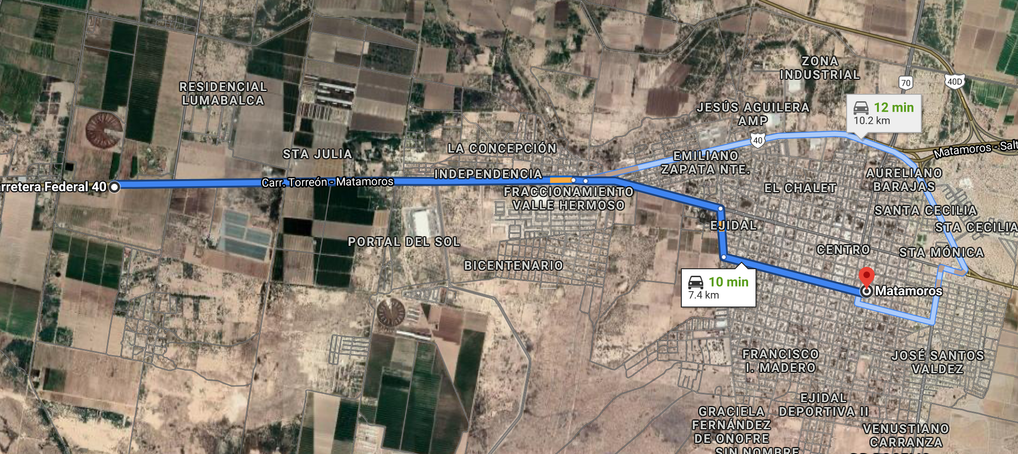
Strategic location in La Laguna Region
4.6 mi. (7.4 km.) from Matamoros, Coahuila downtown.
15

Slide 12
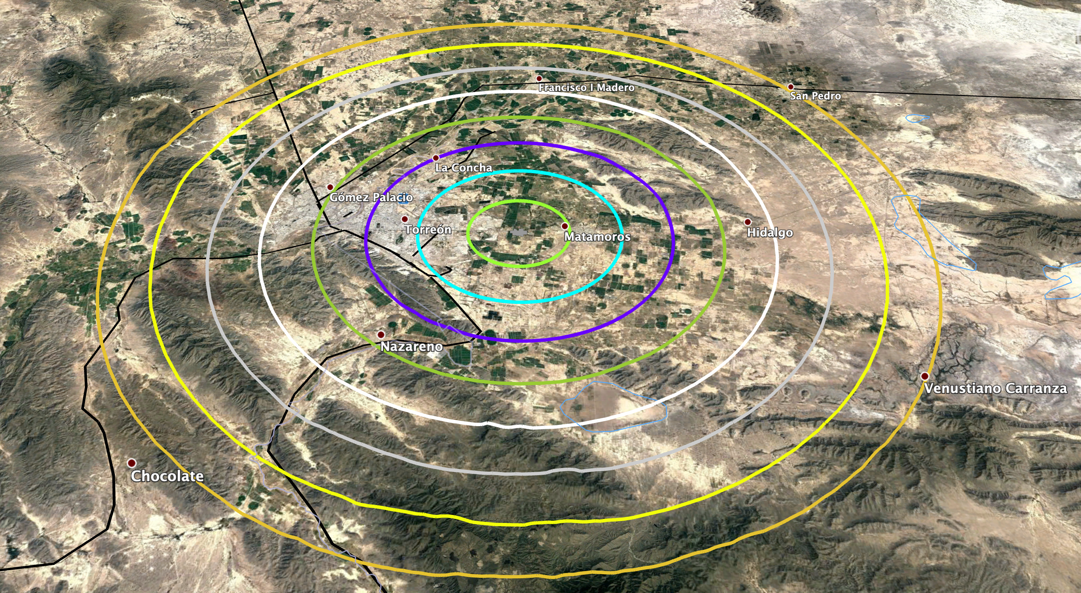

Population around Laguna Industrial Park
 | Total Population | Economic Active Population
5 km. / 3.10 mi. | 54,726 | 33,129
10 km. / 6.21 mi. | 310,099 | 190,930
15 km. / 9.32 mi. | 596,937 | 366,067
20 km. / 12.43 mi. | 819,673 | 495,594
25 km. / 15.53 mi. | 1,077,179 | 653,522
30 km. / 18.64 mi. | 1,127,897 | 683,520
35 km. / 21,75 mi. | 1,151,724 | 697,142
40 km. / 24.85 mi. | 1,193,143 | 720,802
5
10
15
20
25
30
35
40
16

Slide 13

Labor force / education - 40 km radius*
6 Municipalities
4 Coahuila
2 Durango
Average daily salary
$299.35 mxp
Total Population
1,193,143
62 Universities
7,500 Annual average graduates.
Economic Active Population
720,802
23 Technical schools
10,700 Annual average graduates.
Social Security Enrolment
319,167
4 Bilingual schools
(Elementary, junior high school , high school)
Turn over rate (average)
4.04 %
*Source: INEGI, IMSS, ARHL, FOMEC Laguna
17

Slide 14







College graduates in engineering (annual average) *
Industrial
276
Electronics
38
Mechatronic
231
Information technology
226
Mechanic
125
Architecture
185
Electromechanical
93
Computer systems
149
Electrical
66
Civil
125
*Source: FOMEC Laguna
18

Slide 15





Graduates from industrial technical schools (annual average)*
Electronics
784
Industrial maintenance
293
Electrical
537
Electromechanics
261
Automotive maintenance
528
Mechatronics
219
Production
410
Textile
74
Machines and tools
149
*Source: FOMEC Laguna
19

Slide 16
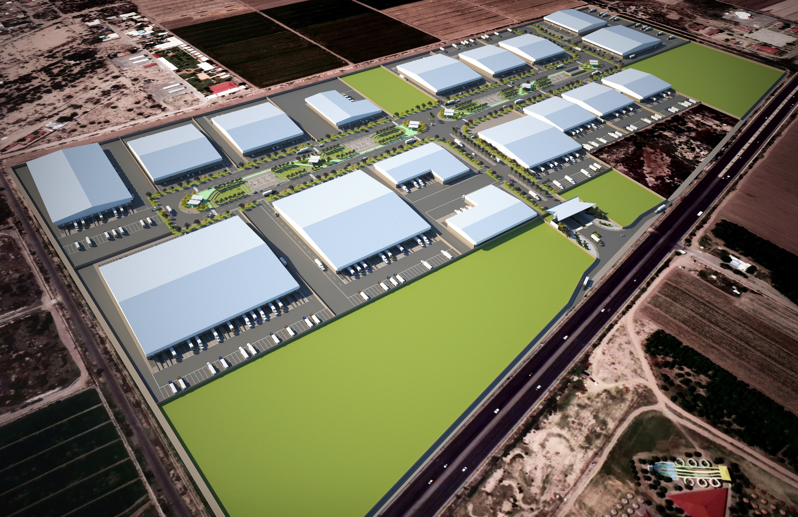
Master Plan
20

Slide 17
Master plan
Project to be develop in three phases: Phase I: 4.74 has. (Under development) Phase II: 15.95 has. (To be developed) Phase III: 20.22 has. (To be developed)
21

Slide 18

Infrastructure
Electrical line médium tension – 13.8 KV
Infraestructure and capacity per hectare – 150 KVA/ha
Public Lightning – LED
Power Supply
Water
Water system SIMAS Matamoros
Drainage system SIMAS Matamoros.
Rain water system – superficial and pipeline
Telecommunication
Feasibility for voice & data network, antenna or fiber optic cable
Security 24/7
Controlled Access
Recreational & commercial areas
Park Administration offices
Internal regulations
Amenities
22

Slide 19

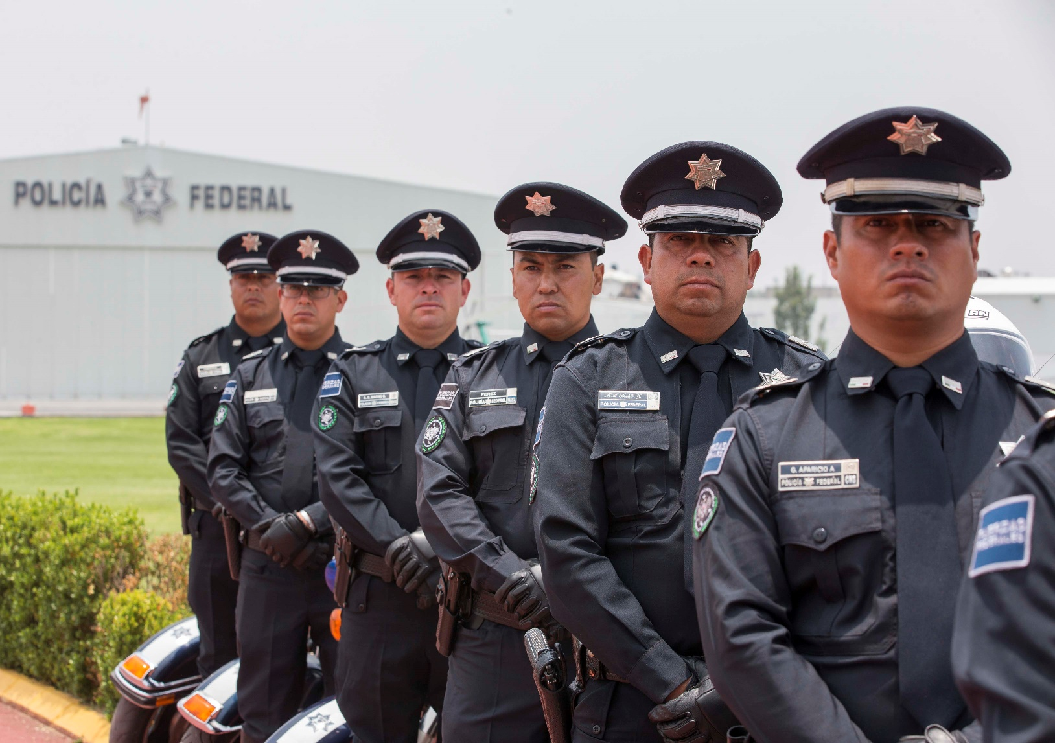
Security and social peace
Coahuila, top 6 of the safest and most peaceful states in the Mexico according to the Institute of Economics and Peace
23

Slide 20
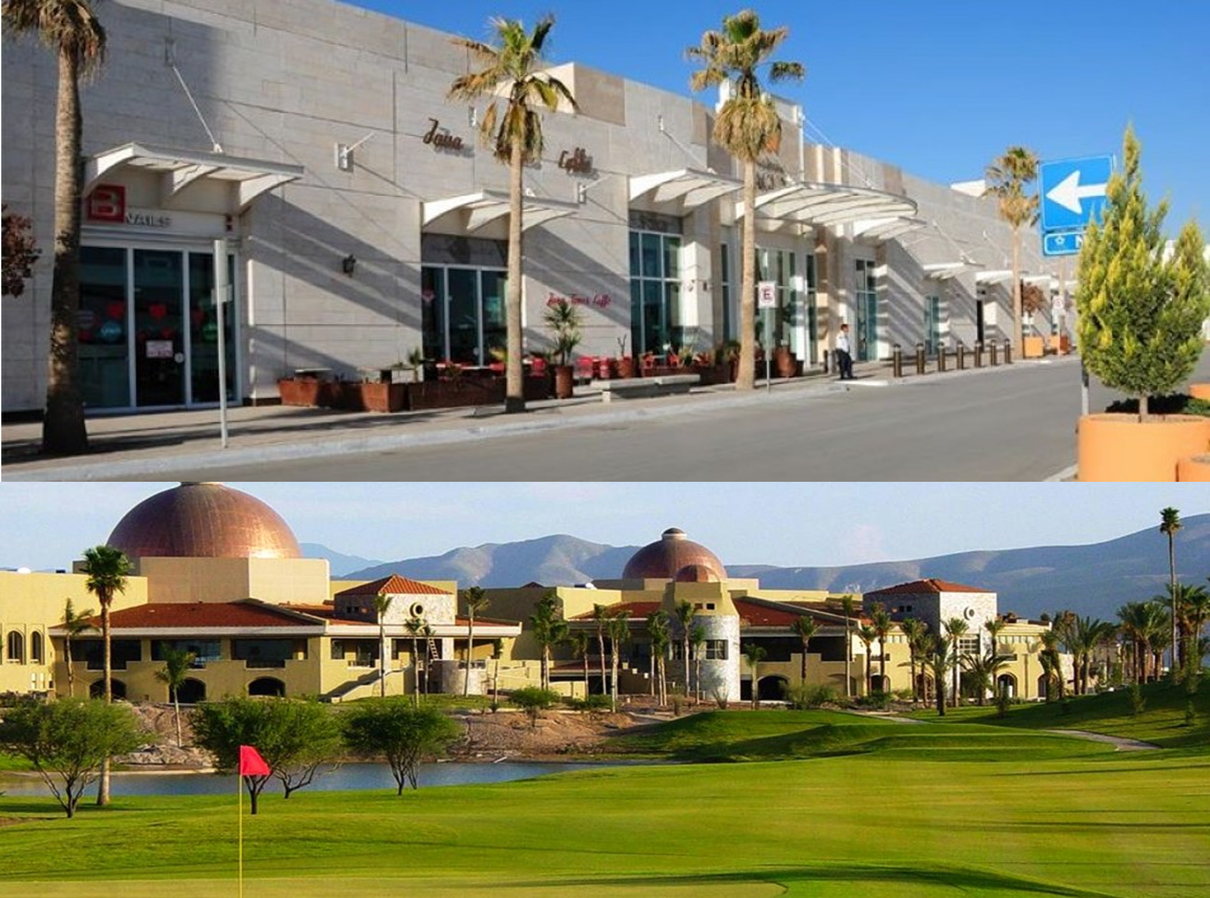
Quality of life in La Laguna
More than 34 medical institutions
More than 65 banks
3 golf courses
4 shopping malls
3 professional teams
More than 20 hotels
LIP provides an excellent quality of life to executives and workers with quality services in entertainment, gastronomy, culture, health and tourism.
24

Slide 21
















Some international companies established in La Laguna Region
25

Slide 22

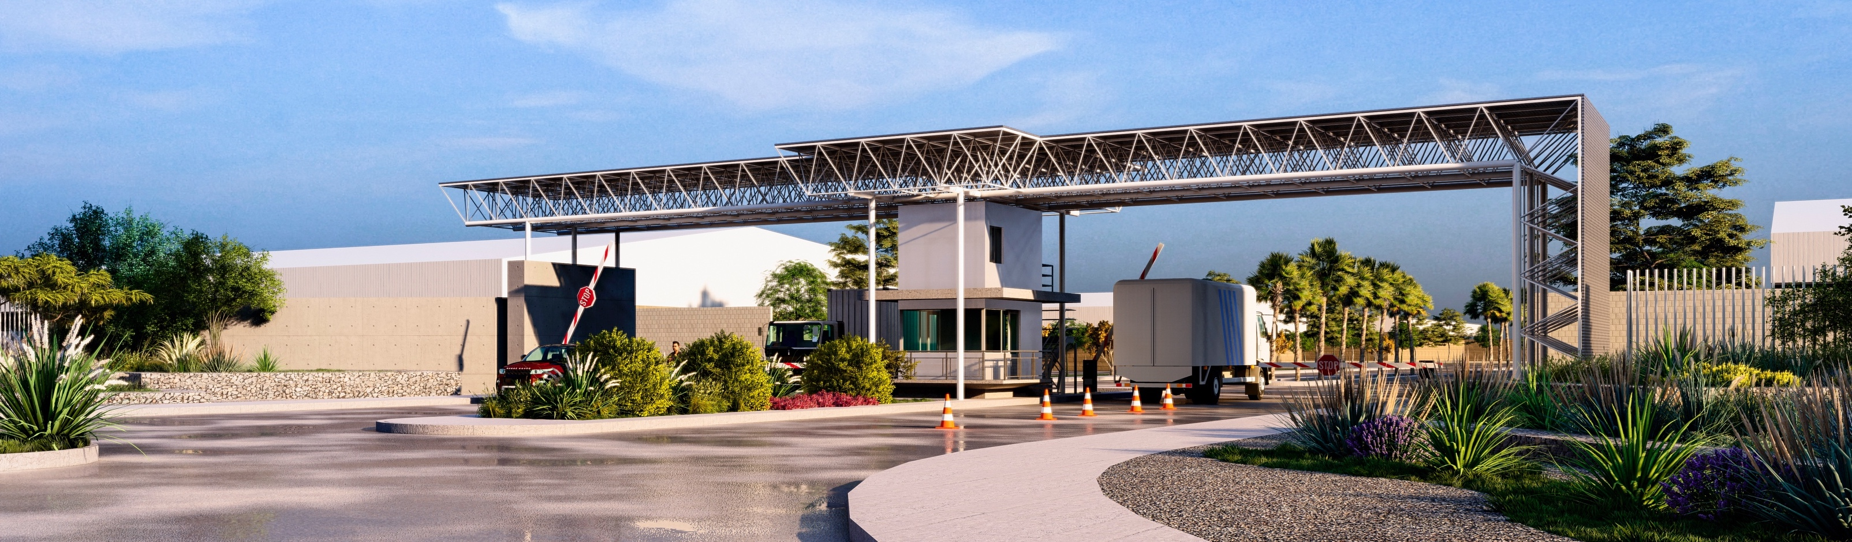
For further information please contact:
Bernardo Lopez
bernardo@lagunaindustrialpark.com

